Slide 1
Verifying Training size leads to further accuracy
A Machine Learning Presentation by Rosalie Sherry
OMSBA5067 – SPQR2021

Slide 2
The dataset : Wine
Features:
Alcohol %
Malic Acid
Ash
Alcalinity of Ash
Magnesium
Total Phenols
Flavanoids
Nonflavanoid Phenols
Proanthocyanins
Color Intensity
Hue
OD280/OD315 of diluted wines
Proline
Target:
Cultivars

Slide 3
Classifiers used
Gaussian Naïve Bayes (Labeled on Graphs as Naïve Bayes)
Decision Tree
Lasso
Polynomial Features (Labeled on Graphs as Poly)
Support Vector Classification (Labeled on Graphs as SVC)

Slide 4
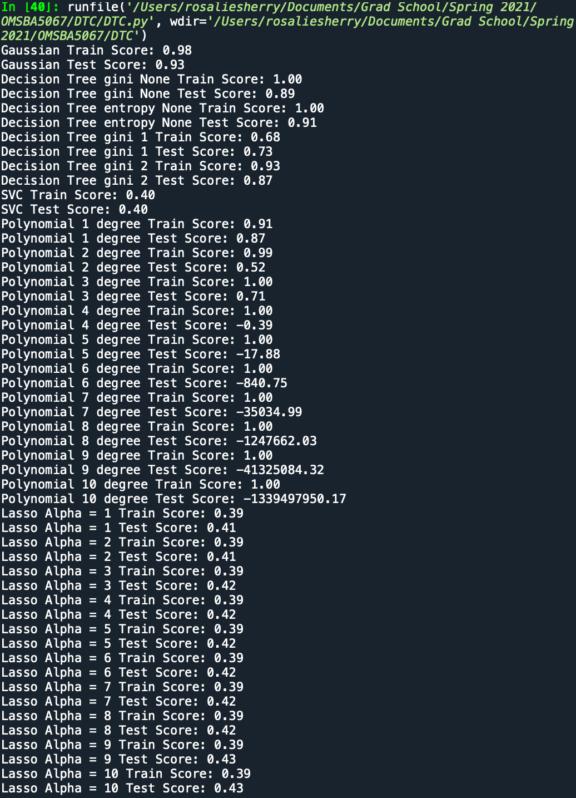
HOW were these determined?

Slide 5


Results
In order of $1/3$Test, ¼ Test, $1/{10}$ Test, $1/{20}$ Test

Slide 6
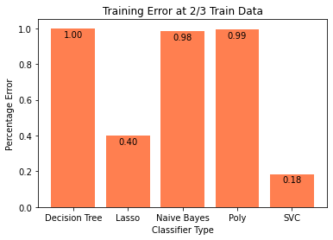
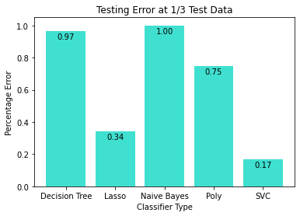
Results 2/3 train versus 1/3 test

Slide 7
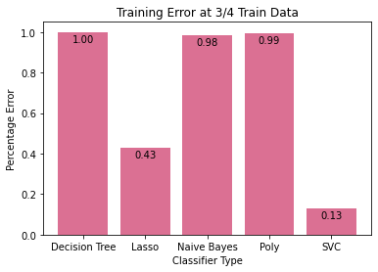
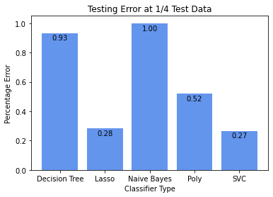
RESULTS ¾ Train versus ¼ Test

Slide 8
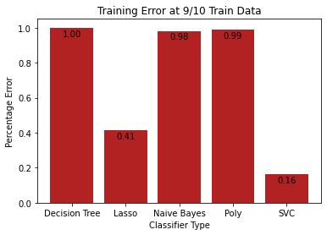
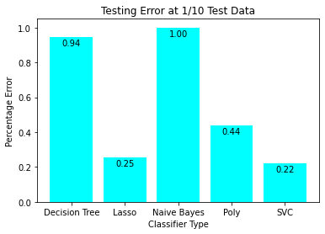
Results 9/10 train versus 1/10 test

Slide 9
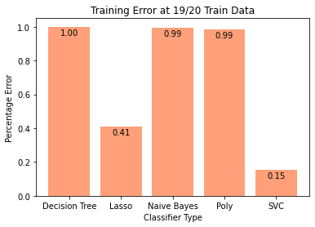
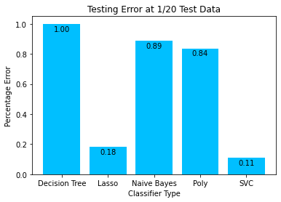
Results 19/20 train versus 1/20 test

Slide 10
Further investigations with this data set

Slide 11
Further questions influenced by this data

